Slide 1
EMPLOYEE PAYROLL CALCULATION
STUDENT NAME: Jayasree J
REGISTER NO: 312200849
DEPARTMENT: B.Com General 3rd Year
COLLEGE : Pachaiyappa’s College for Women, Kanchipuram

Slide 2
PROJECT TITLE
Employee Payroll Calculation

Slide 3


Overview
The Payroll system will automatically determine:
If there is overtime
If it should be paid or accrued
If it is at straight time or time and a half
As long as ACT (Actual Hours Worked) is Coded
3/21/2024 Annual Review

Slide 4
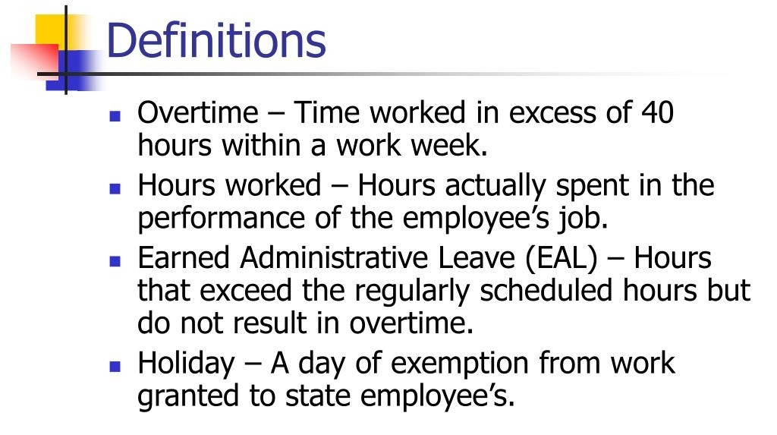


Slide 5
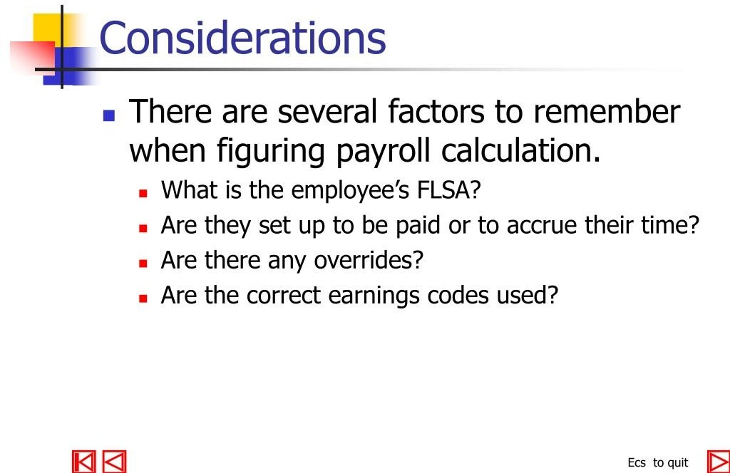


Slide 6
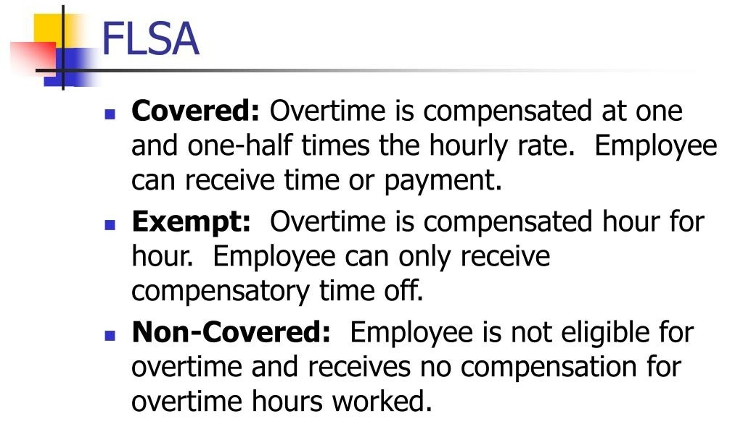


Slide 7
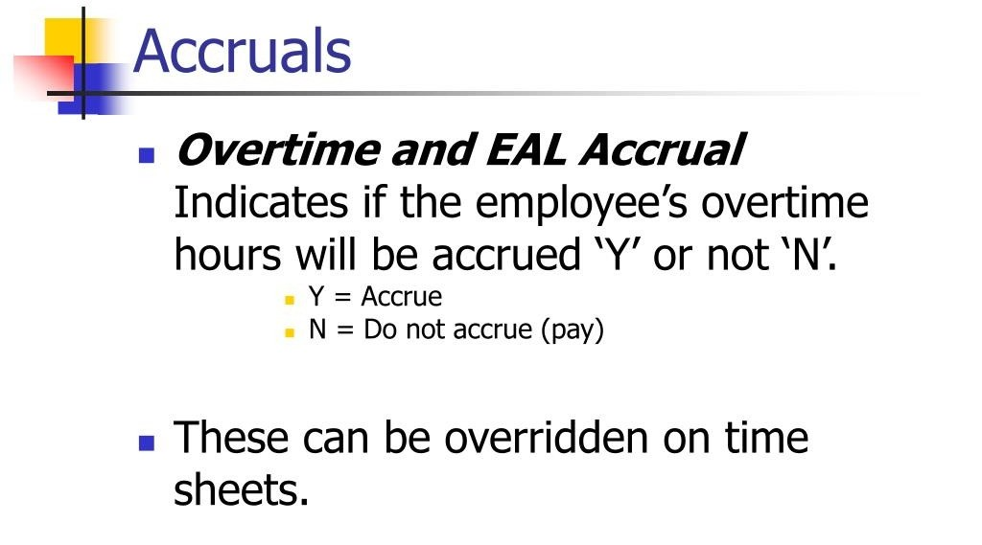



Slide 8
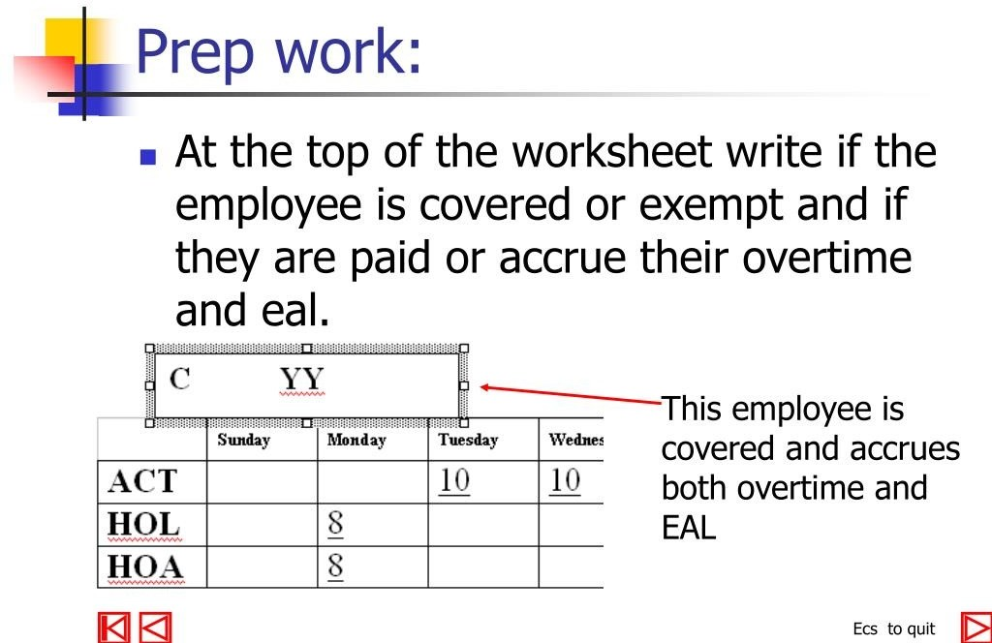

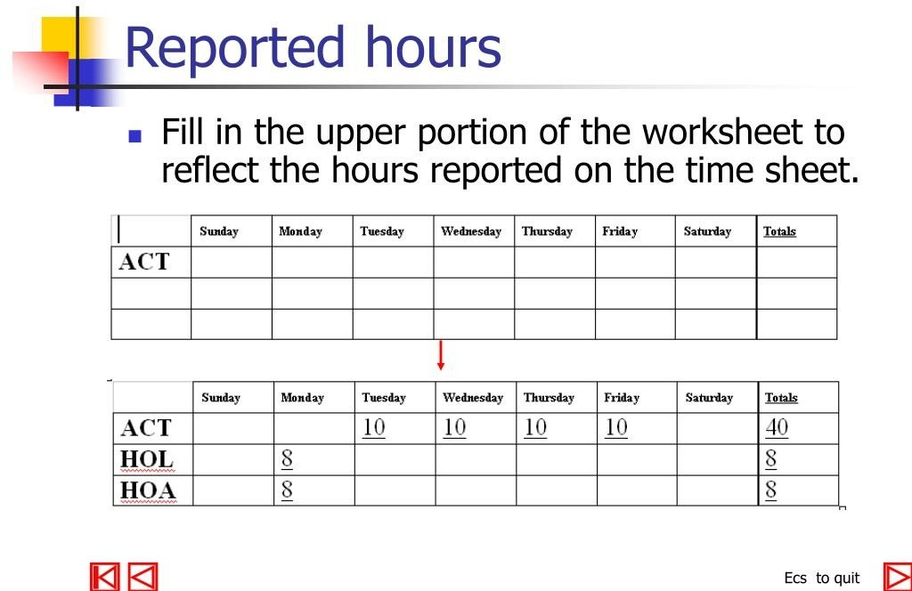
3/21/2024 Annual Review
8

Slide 9
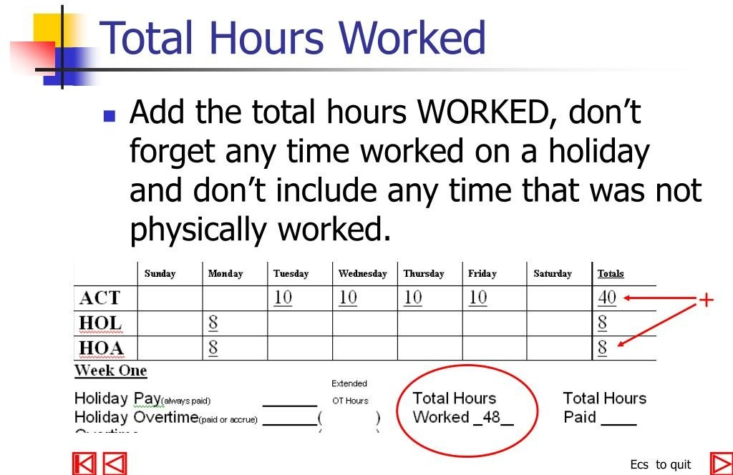
9

Slide 10
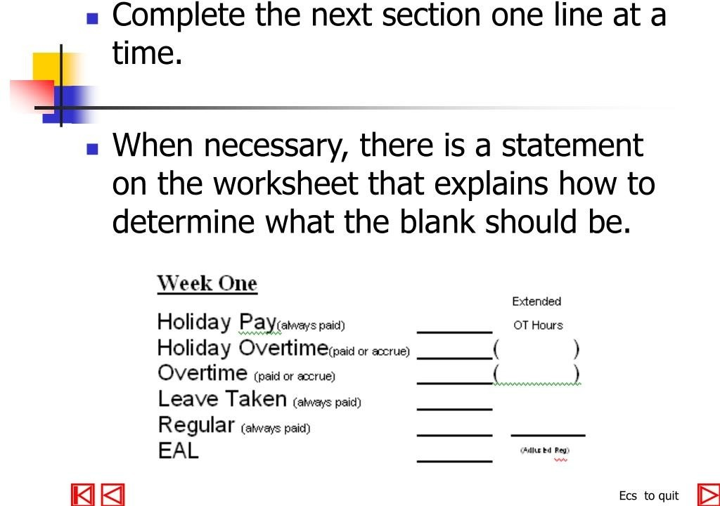
10

Slide 11
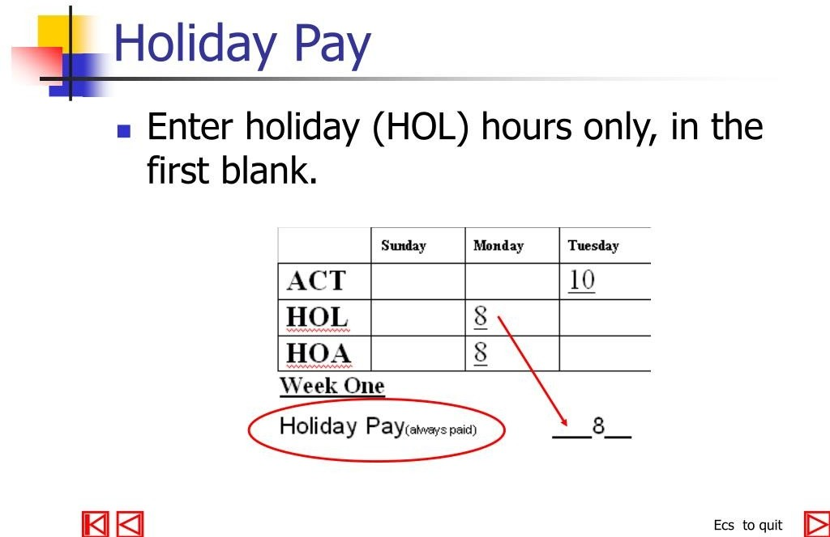
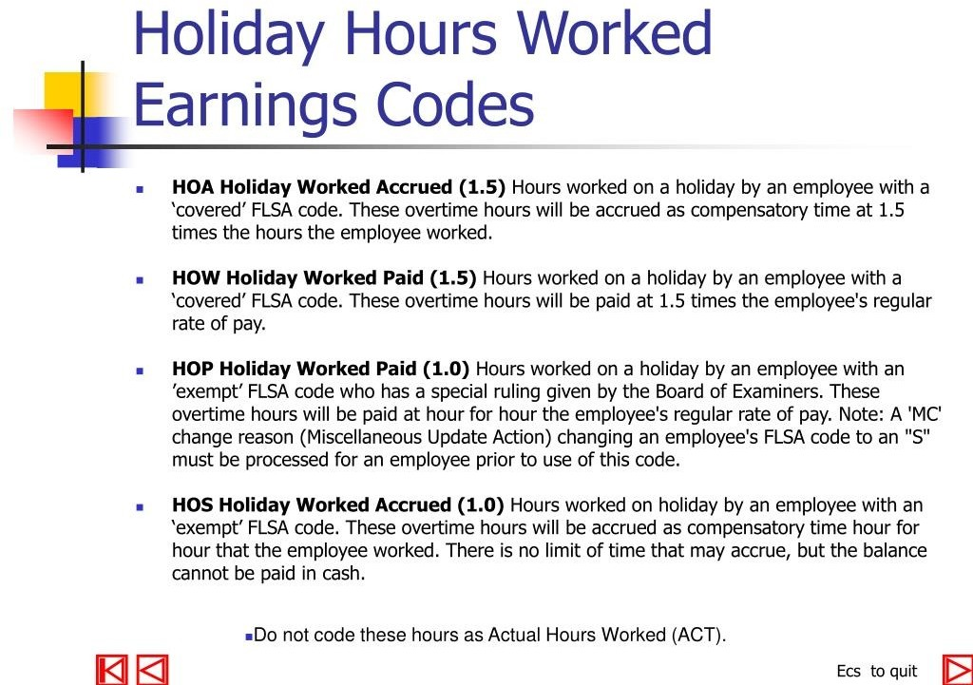
11

Slide 12
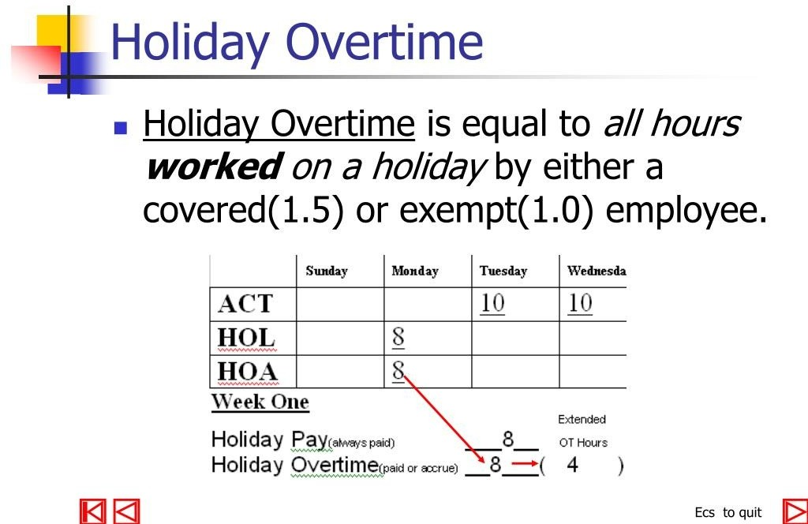
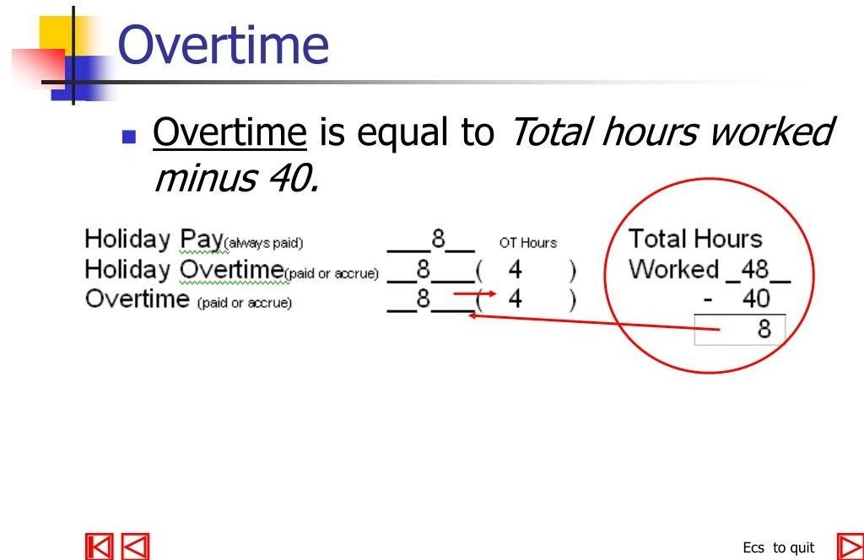
12

Slide 13
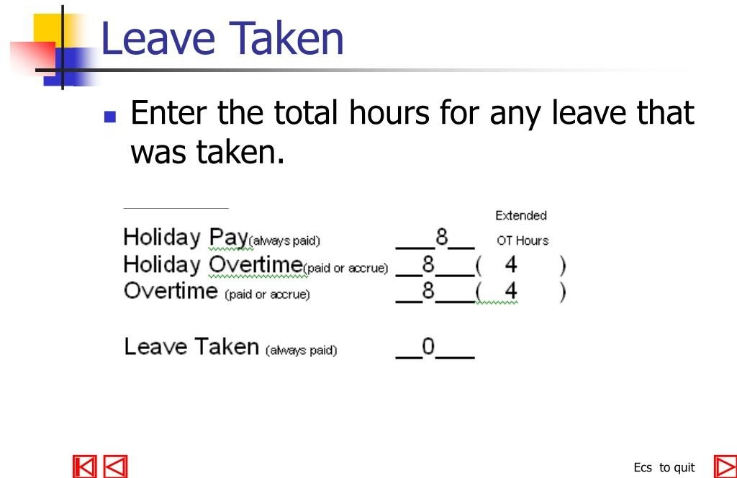
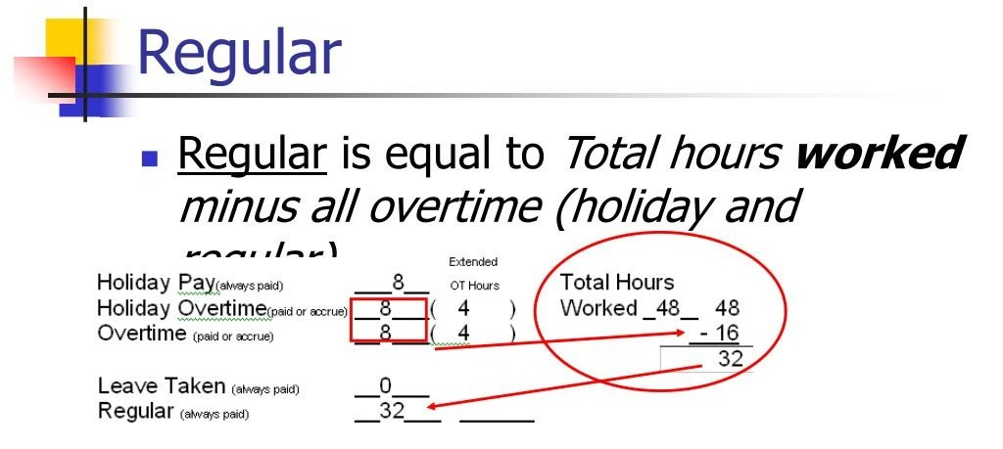
13

Slide 14
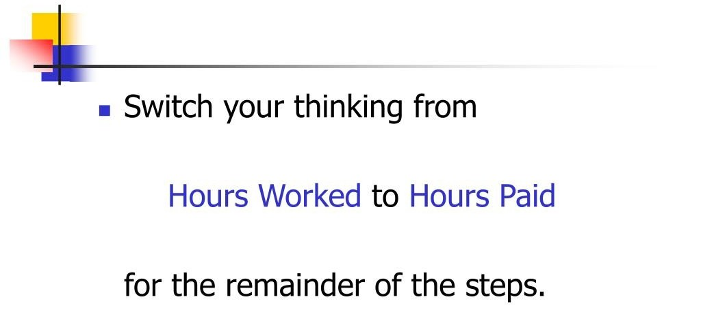
14

Slide 15
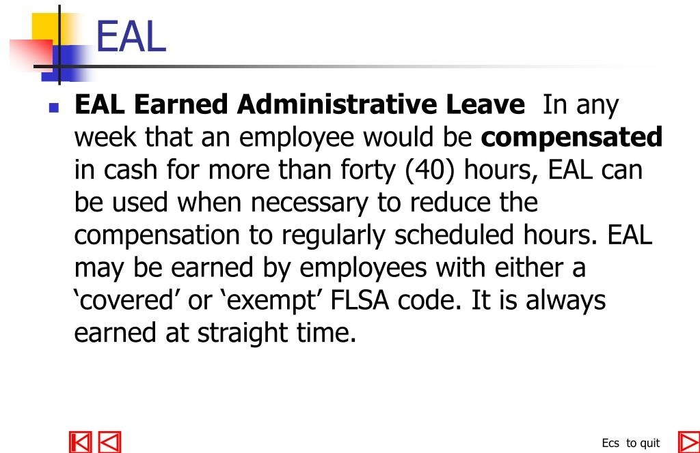
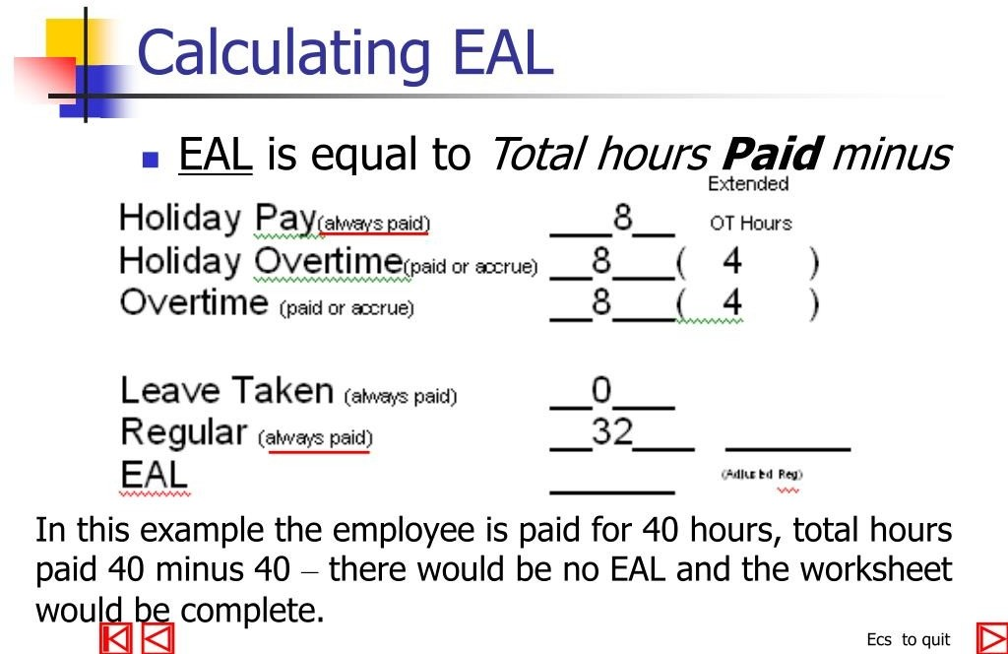
15

Slide 16
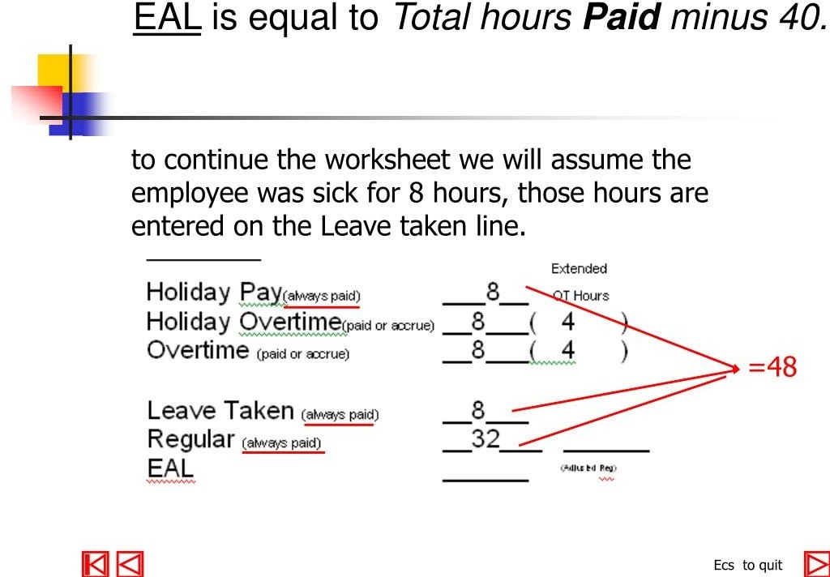
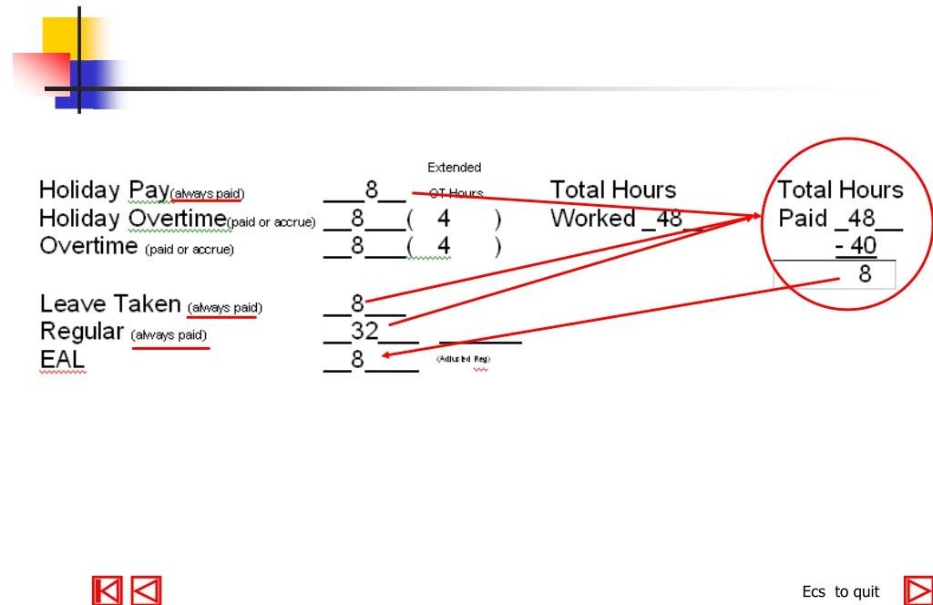
16

Slide 17
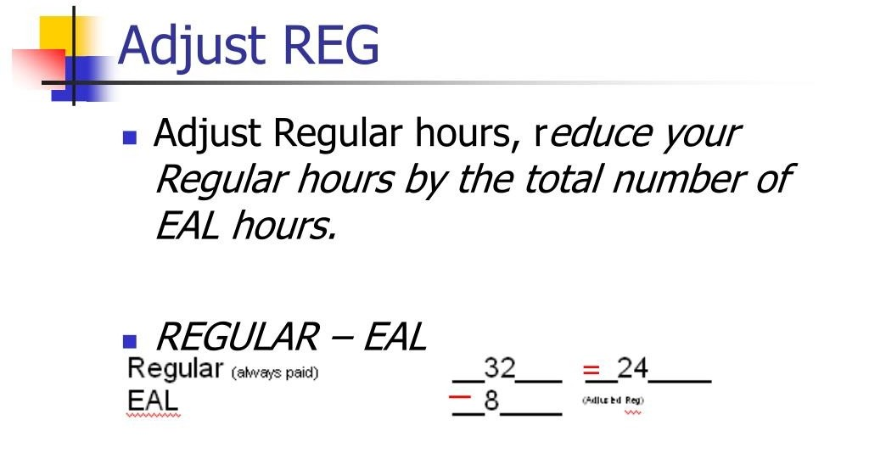
17

Slide 18
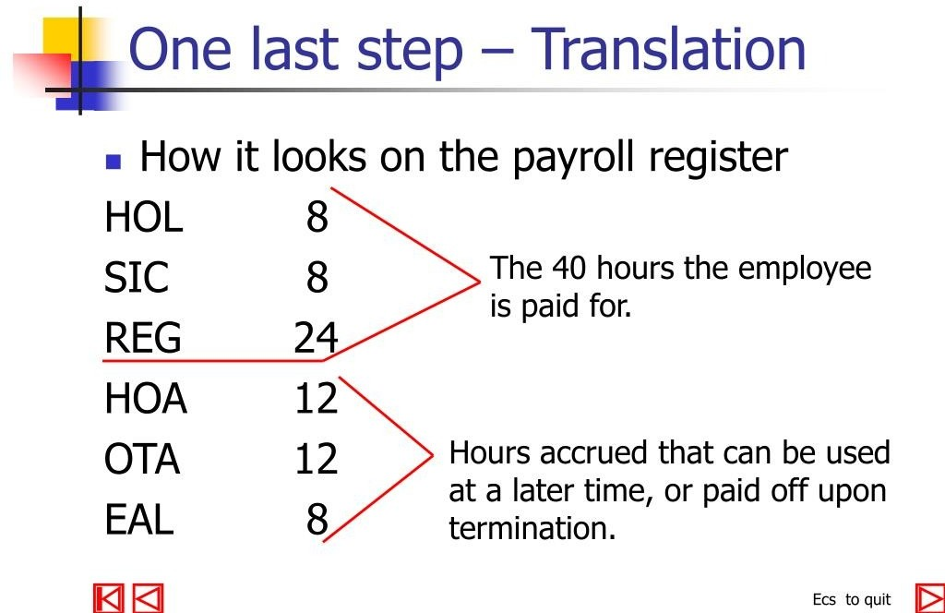
18

Slide 19
conclusion
To calculate gross pay for salaried employees, one must multiply the employee's total yearly salary by the number of pay periods in a year. On the other hand, for hourly employees, the gross pay is calculated by multiplying the number of hours worked by the hourly wage.
Net pay is the final payout that is disbursed to an employee after all the necessary deductions made. Gross pay = Basic salary + HRA + DA + Allowances + One-time payment/incentive (Reimbursements, Arrears, Bonus, etc.)
A payroll management system describes the specialist software that can empower companies by streamlining and automatically carrying out the processes involved in payroll such as working out take home pay and taxes – saving time for the employer and reducing the number of errors.

